Slide 1
Introduction
1

Slide 2


What is Software Engineering?
Engineering approach to develop software.
–Building Construction Analogy.
Systematic collection of past experience:
–Techniques,
–Methodologies,
–Guidelines.
2

Slide 3
IEEE Definition
“Software engineering is the application of a systematic, disciplined, quantifiable
approach to the development, operation, and maintenance of software; that is, the application of engineering to software.”
3

Slide 4
Software Crisis
It is often the case that software products:
–Fail to meet user requirements.
–Expensive.
–Difficult to alter, debug, and enhance.
–Often delivered late.
–Use resources non-optimally.
4

Slide 5
Software Crisis (cont.)
Laptop or Desktop = Rs.45,000/-
Rational suite node locked = Rs.3,14,600/-
Rational suite floating license=
Rs.6,03,200/-
Hw cost Sw cost
1960
Year
2018
Relative Cost of Hardware and Software
5

Slide 6
Then why not have entirely hardware systems?...
A virtue of software:
  Relatively easy and faster to develop and to change…
  Consumes no space, weight, or power…
  Otherwise all might as well be hardware.
The more is the complexity of software, the harder it is to change--why?
  Further, the more the changes made to a program, the greater becomes its complexity.
6

Slide 7
28% Successful
Standish Group Report
49% Delayed or
cost overrun
23% Cancelled
7

Slide 8
Which Factors are Contributing to the Software Crisis?
Larger problems,
Poor project management
•
Lack of adequate training in software engineering,
Increasing skill shortage,
Low productivity improvements.
8

Slide 9
Programming: an Art or Engineering?
Esoteric Past Experience
Engineering
Technology Development Pattern
Technology
Craft
Systematic Use of Past Experience and Scientific Basis
Unorganized Use of Past Experience
Art
Time
9

Slide 10
Heavy use of past experience:
–Past experience is systematically arranged.
Programming
an Art or Engineering?
Theoretical basis and quantitative techniques provided.
Many are just thumb rules.
Tradeoff between alternatives.
Pragmatic approach to cost-effectiveness.

Slide 11
Early programmers used exploratory
(also called build and fix) style.
  A `dirty' program is quickly developed.
  The bugs are fixed as and when they are noticed.
  Similar to how a junior student develops programs…
What is Exploratory Software Development?

Slide 12
Exploratory Style
Fix
Initial
Coding
Test
Do Until
Done
Does not work for nontrivial projects… Why?...
13

Slide 13
What is Wrong with the Exploratory Style?
Can successfully be used for developing only very small (toy)
programs.
Software Engineering
Machine
Exploratory
Effort, time, cost
Program Size

Slide 14
What is Wrong with the Exploratory Style?
Cont…
Besides the exponential growth of effort, cost, and
time with problem size:
  Exploratory style usually results in unmaintainable code.
  It becomes very difficult to use the exploratory style in team development environments…

Slide 15
What is Wrong with the Exploratory Style? Cont…
Why does the effort required to develop a software grow exponentially with size?
Why does the approach completely breaks down when the size of software becomes large?
Software Engineering
Exploratory
Effort, time, cost
Machine
Program Size

Slide 16
What is the Implication in Program Development?
A small program having just a few variables:
  Is within easy grasp of an individual.
As the number of independent variables in the program increases:
  It quickly exceeds the grasping power of an individual…
  Requires an unduly large effort to master the problem.

Slide 17
Implication in Program Development
Instead of a human, if a machine could be writing (generating) a program,
  The slope of the curve would be linear.
But, how does use of software engineering principles helps hold down the effort-size curve to be almost linear?
  Software engineering principles extensively use techniques
specifically targeted to overcome the human cognitive limitations.

Slide 18
Which Principles are Deployed by Software Engineering Techniques to Overcome Human Cognitive Limitations?
Two important principles are profusely used:
  Abstraction
  Decomposition

Slide 19
Two Fundamental Techniques to Handle Complexity

Slide 20
What is Abstraction?
Simplify a problem by omitting unnecessary details.
  Focus attention on only one aspect of the problem and ignore other aspects and irrelevant details.
  Also called model building.

Slide 21
Suppose you are asked to develop an overall
understanding of some country.
– Would you:
Abstraction Example
Meet all the citizens of the country, visit every house, and examine every tree of the country?
– You would possibly refer to various types of maps for that country only.
21

Slide 22
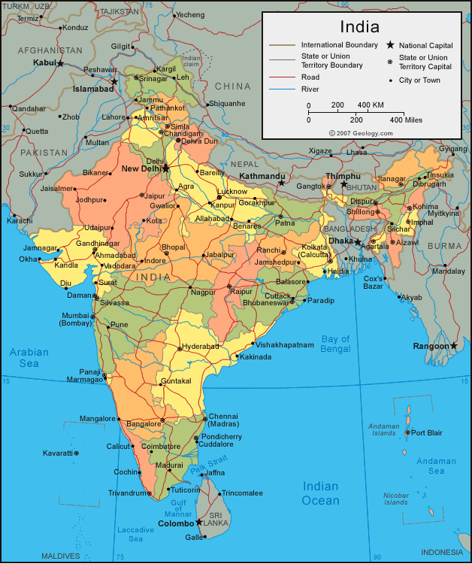
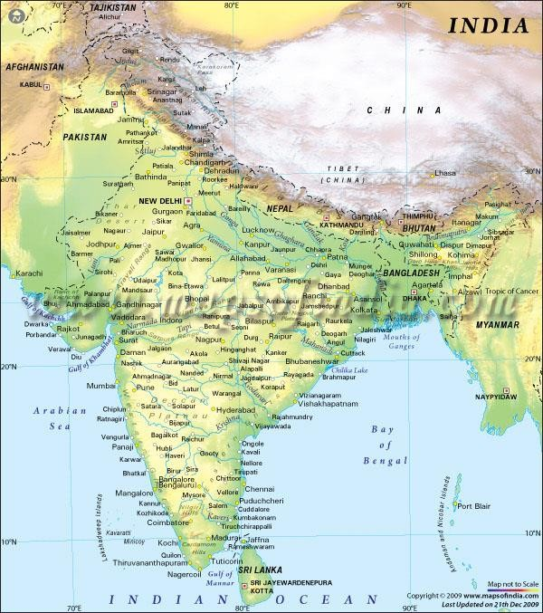
You would study an Abstraction…
A map is:
  An abstract representation of a country.
  Various types of maps (abstractions) possible.
22

Slide 23

Does every Problem have a single Abstraction?
Several abstractions of the same problem can be created:
  Focus on some specific aspect and ignore the rest.
  Different types of models help understand different aspects of the problem.
23

Slide 24
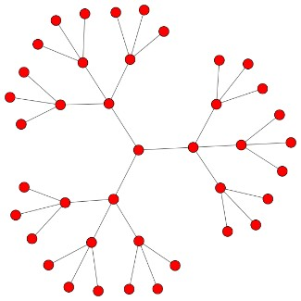
For complex problems:
– A single level of abstraction is inadequate.
Abstractions of
Complex Problems
– A hierarchy of abstractions may have to be constructed.
Hierarchy of models:
  A model in one layer is an abstraction of the lower layer model.
  An implementation of the model at the higher layer.
24

Slide 25
Abstraction of Complex Problems -- An Example
Suppose you are asked to understand all life forms that inhabit the earth.
Would you start examining each living organism?
  You will almost never complete it.
  Also, get thoroughly confused.
Solution: Try to build an abstraction hierarchy.
25

Slide 26
Animalia
Plantae
Fungae
Kingdom
Living Organisms
Mollusca
Chordata
Ascomycota
Zygomycota
Phyllum
Homo Sapien
Solanum
Tuberosum
Coprinus
Comatus
Species
26

Slide 27
Quiz
What is a model?
Why develop a model? That is, how does constructing a model help?
Give some examples of models.
27

Slide 28

Decomposition
Decompose a problem into many small independent parts.
  The small parts are then taken up one by one and solved separately.
  The idea is that each small part would be easy to grasp and therefore can be easily solved.
  The full problem is solved when all the parts are solved.
28

Slide 29


Decomposition
A popular example of decomposition principle:
  Try to break a bunch of sticks tied
together versus breaking them individually.
Any arbitrary decomposition of a problem may not help.
  The decomposed parts must be more or less independent of each other.
29

Slide 30
Decomposition: Another Example
Example use of decomposition principle:
  You understand a book better when the contents are organized into independent chapters.
  Compared to when everything is mixed up.
30

Slide 31
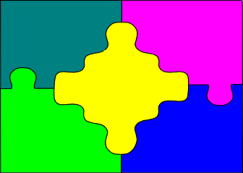
Why Study Software Engineering? (1)
To acquire skills to develop large programs.
–Handling exponential growth in complexity with size.
–Systematic techniques based on abstraction (modelling) and decomposition.

Slide 32
Why Study Software Engineering? (2)
Learn systematic techniques of:
–Specification, design, user interface development, testing, project management, maintenance, etc.
–Appreciate issues that arise in team development.

Slide 33
Why Study Software Engineering? (3)
To acquire skills to be a better programmer:
  Higher Productivity
  Better Quality Programs

Slide 34
Uncertainty of outcome
Routine
Jobs versus
Projects
Jobs
Projects
Exploration
Jobs – repetition of very well-defined and well understood tasks with very little uncertainty
Exploration – The outcome is very uncertain, e.g. finding a cure for cancer.
Projects – in the middle! Has challenge as well as routine…
43

Slide 35
Two types of software projects:
–Products (Generic software)
–Services (custom software)
Types of Software Projects
Total business – Several Trillions of US $
–Half in products and half services
–Services segment is growing fast!
44

Slide 36




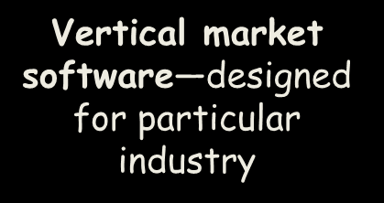


Packaged software — prewritten software available for purchase
Horizontal market software—meets needs of many companies
Vertical market software—designed for particular industry
Custom software — software developed at some user’s requests-Usually developer tailors some generic solution
Types of Software
36

Slide 37
Types of Software Projects
Software product development projects
Software services projects
37

Slide 38

Software Services
Software service is an umbrella term, includes:
  Software customization
CP
  Software maintenance
  Software testing
  Also contract programmers (CP) carrying out coding or any other assigned activities.
38

Slide 39
Factors responsible for accelerated growth of services…
Now lots of code is available in a company:
  New software can be developed by modifying the closest.
Speed of Conducting Business has increased tremendously:
  Requires shortening of project duration
48

Slide 40
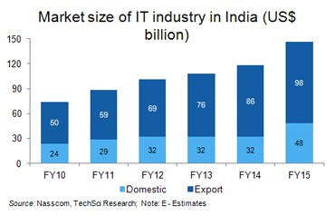
Contribution of the IT sector to India’s GDP rose to approximately 9.5%
in 2015 from 1.2%
in 98
40

Slide 41
Scenario of Indian Software Companies
Indian companies have largely focused on the services segment --
- Why?
41

Slide 42
A Few Changes in Software Project Characteristics over Last 40 Years
40 years back, very few software existed
  Every project started from scratch
  Projects were multi year long
The programming languages that were used earlier hardly provided any scope for reuse:
  FORTRAN, PASCAL, COBOL, BASIC
No application was GUI-based:
  Mostly command selection from displayed text menu items.
51

Slide 43
Traditional versus Modern Projects
Projects are increasingly becoming services:
– Either tailor some existing software or reuse pre-built libraries.
Facilitate and accommodate client feedbacks
Facilitate customer participation in project development work
Incremental software delivery with evolving functionalities.
No software is being developed from scratch --- Significant reuse is being made…
52

Slide 44
Computer Systems Engineering
Many products require development of software as well as specific hardware to run it:
– a coffee vending machine,
–a robotic toy,
–A new health band product, etc.
Computer systems engineering:
–encompasses software engineering.

Slide 45
Computer Systems Engineering
The high-level problem:
–Deciding which tasks are to be solved by software.
–Which ones by hardware.

Slide 46
Computer Systems Engineering (CONT.)
Typically, hardware and software are developed together:
–Hardware simulator is used during software development.
Integration of hardware and software.
Final system testing

Slide 47
Computer Systems Engineering (CONT.)
Feasibility Study
Requirements Analysis and Specification
Hardware
Development
Hardware
Software Partitioning
Software Development
Integration
and Testing
Project
Management
47

Slide 48
Emergence of Software Engineering Techniques
48

Slide 49
Emergence of Software Engineering Techniques
Early Computer Programming (1950s):
–Programs were being written in assembly language…
–Sizes limited to about a few hundreds of lines of assembly code…

Slide 50
Early Computer Programming (50s)
Every programmer developed his/her own style of writing programs:
–According to his intuition (called exploratory or build-and-fix programming) .

Slide 51
High-Level Language Programming (Early 60s)
High-level languages such as FORTRAN, ALGOL, and COBOL were introduced:
  This reduced software development efforts greatly.
  Why reduces?

Slide 52
High-Level Language Programming (Early 60s)
Software development style was still exploratory.
  Typical program sizes were limited to a few thousands of lines of source code.

Slide 53
Control Flow-Based Design (late 60s)
Size and complexity of programs increased further:
–Exploratory programming style proved to be insufficient.
Programmers found:
–Very difficult to write cost-effective and correct programs.

Slide 54
Control Flow-Based Design (late 60s)
Programmers found it very difficult:
–To understand and maintain programs written by others.
To cope up with this problem, experienced programmers advised---”Pay particular attention to the design of the program's control structure.'’

Slide 55
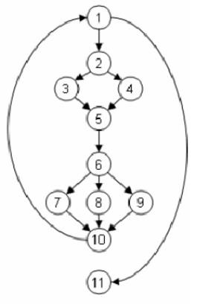
Control Flow-Based Design (late 60s)
What is a program's control structure?
– The sequence in which the program's instructions are executed.
To help design programs having good control structure:
–Flow charting technique was developed.

Slide 56
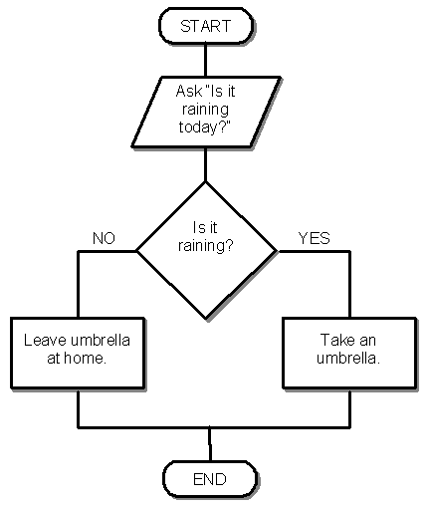
Control Flow-Based Design (late 60s)
Using flow charting technique:
–One can represent and design a program's control structure.
–When asked to understand a program:
  One would mentally trace the program's execution sequence.

Slide 57
Control Flow-Based Design
A program having a messy flow chart representation:
–Difficult to understand and debug.

Slide 58
Spaghetti Code Structure

Slide 59
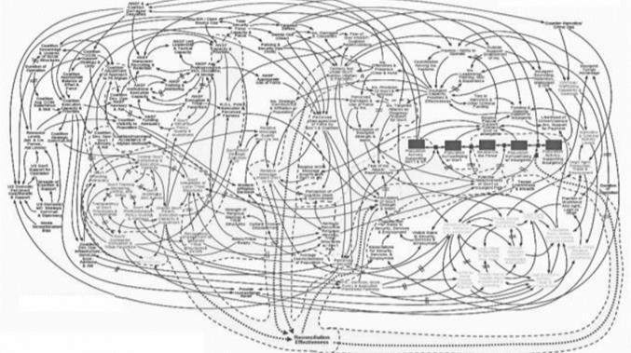
Control Flow-Based Design (Late 60s)
What causes program complexity?
–GO TO statements makes control structure of a program messy.
–GO TO statements alter the flow of control arbitrarily.
–The need to restrict use of GO TO statements was recognized.

Slide 60
Control Flow-Based Design (Late 60s)
addi $a0, $0, 1 j next
next:
j skip1
add $a0, $a0, $a0 skip1:
j skip2
add $a0, $a0, $a0 add $a0, $a0, $a0 skip2:
j skip3
loop:
add $a0, $a0, $a0 add $a0, $a0, $a0 add $a0, $a0, $a0 skip3:
j loop
Many programmers had extensively used assembly languages.
–JUMP instructions are frequently used for program branching in assembly languages.
–Programmers considered use of GO TO statements inevitable.
69

Slide 61
Control-flow Based Design (Late 60s)
At that time, Dijkstra published his article:
–“Goto Statement Considered Harmful” Comm. of ACM, 1969.
Many programmers were unhappy to read his article.

Slide 62
Control Flow-Based Design (Late 60s)
Some programmers published several counter articles:
–Highlighted the advantages and inevitability of GO TO statements.

Slide 63
Control Flow-Based Design (Late 60s)
It soon was conclusively proved:
–Only three programming constructs are sufficient to express any programming logic:
  sequence (a=0;b=5;)
  selection (if(c==true) k=5 else m=5;)
  iteration (while(k>0) k=j-k;)

Slide 64
Control-flow Based Design (Late 60s)
Everyone accepted:
–It is possible to solve any programming problem without using GO TO statements.
–This formed the basis of Structured Programming methodology.

Slide 65
Structured Programming
A program is called structured:
–When it uses only the following types of constructs:
  sequence,
  selection,
  iteration
–Consists of modules.

Slide 66
Structured Programs
Sometimes, violations to structured programming are permitted:
  Due to practical considerations such as:
  Premature loop exit (break) or for exception handling.

Slide 67
Advantages of Structured programming
Structured programs are:
–Easier to read and understand,
–Easier to maintain,
–Require less effort and time for development.
–Less buggy

Slide 68
Structured Programming
Research experience shows:
–Programmers commit less number of errors:
  While using structured if-then-else and do-while statements.
  Compared to test-and-branch (GOTO) constructs.

Slide 69
Data Structure-Oriented Design (Early 70s)
As program sizes increased further, soon it was discovered:
–It is important to pay more attention to the design of data structures of a program
  Than to the design of its control structure.

Slide 70



Data Structure-Oriented Design (Early 70s)
Techniques which emphasize designing the data structure:
–Derive program structure from it:
  Are called data structure-oriented design techniques.

Slide 71
Data Structure Oriented Design (Early 70s)
An example of data structure-oriented design technique:
–Jackson's Structured Programming(JSP) methodology
  Developed by Michael Jackson in 1970s.

Slide 72
Data Structure Oriented Design (Early 70s)
JSP technique:
  Program code structure should correspond to the data structure.

Slide 73
A Data Structure Oriented Design
JSP methodology:
(Early 70s)
A program's data structures are first designed using notations for
  sequence, selection, and iteration.
The data structure design is then used :
  To derive the program structure.

Slide 74
Data Structure Oriented Design (Early 70s)
Several other data structure-oriented Methodologies also exist:
  e.g., Warnier-Orr Methodology.

Slide 75
Data Flow-Oriented Design
(Late 70s)
Data flow-oriented techniques advocate:
–The data items input to a system must first be identified,
–Processing required on the data items to produce the required outputs should be determined.

Slide 76
Data Flow-Oriented Design (Late 70s)
Data flow technique identifies:
–Different processing stations (functions) in a system.
–The items (data) that flow between processing stations.

Slide 77
Data Flow-Oriented Design (Late 70s)
Data flow technique is a generic technique:
–Can be used to model the working of any system.
  not just software systems.
A major advantage of the data flow technique is its simplicity.

Slide 78
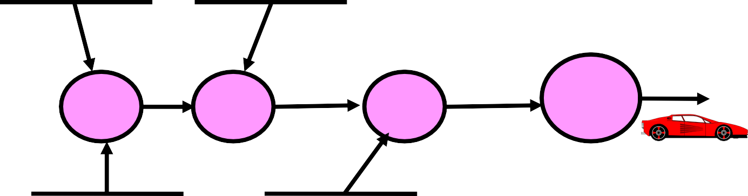
Data Flow Model of a Car Assembly Unit
Engine
Store
Door
Store
Chassis with Engine
Fit
Doors
Partly Assembled Car
Fit Engine
Fit Wheels
Paint and Test
Car
Assembled
Car
Chassis
Store
Wheel Store
87

Slide 79
Object-Oriented Design (80s)
Object-oriented technique:
–An intuitively appealing design approach:
–Natural objects (such as employees, pay-roll-register, etc.) occurring in a problem are first identified.

Slide 80
Object-Oriented Design (80s)
Relationships among objects:
–Such as composition, reference, and inheritance are determined.
Each object essentially acts as:
–A data hiding (or data abstraction) entity.

Slide 81
Object-Oriented Techniques have gained wide acceptance:
– Simplicity
Object-Oriented Design (80s)
– Increased Reuse possibilities
Lower development time and cost
More robust code
Easy maintenance

Slide 82
Aspect- oriented
Component- based
Service- oriented
Object-Oriented
Object-Oriented
Data flow-based
Data structure- based
Evolution of Design Techniques
Control flow- based
Ad hoc
91

Slide 83
Evolution of Other Software Engineering Techniques
The improvements to the software design methodologies
–are indeed very conspicuous.
In additions to the software design techniques:
–Several other techniques evolved.

Slide 84
Life cycle models,
Specification techniques,
Project management techniques,
Testing techniques,
Debugging techniques,
Quality assurance techniques,
Metrics,
CASE tools, etc.
Evolution of Other Software Engineering Techniques

Slide 85
Use of Life Cycle Models
Software is developed through several well-defined stages:
–Requirements analysis and specification,
–Design,
–Coding,
–Testing, etc.
Differences between the exploratory style and modern software development practices

Slide 86
Differences between the exploratory style and modern software development practices
Emphasis has shifted
– from error correction to error prevention.
Modern practices emphasize:
–detection of errors as close to their point of introduction as possible.

Slide 87
Differences between the exploratory style and
modern software development practices
(CONT.)
In exploratory style,
–errors are detected only during testing,
Now:
– Focus is on detecting as many errors as possible in each phase of development.

Slide 88
Differences between the exploratory style and modern software development practices (CONT.)
In exploratory style:
–coding is synonymous with program development.
Now:
–coding is considered only a small part of program development effort.

Slide 89
Differences between the exploratory style and modern software development practices (CONT.)
A lot of effort and attention is now being paid to:
–Requirements specification.
Also, now there is a distinct design phase:
–Standard design techniques are being used.

Slide 90
Differences between the exploratory style and modern software development practices (CONT.)
During all stages of development process:
–Periodic reviews are being carried out
Software testing has become systematic:
–Standard testing techniques are available.

Slide 91
Differences between the exploratory style and modern software
development practices (CONT.)
There is better visibility of design and code:
  Visibility means production of good quality, consistent and standard documents.
  In the past, very little attention was being given to producing good quality
and consistent documents.
  We will see later that increased visibility makes software project
management easier.
91

Slide 92
Differences between the exploratory style and modern software development practices (CONT.)
Because of good documentation:
–fault diagnosis and maintenance are smoother now.
Several metrics are being used:
–help in software project management, quality assurance, etc.
92

Slide 93
Differences between the exploratory style and modern software development practices (CONT.)
Projects are being properly planned:
–estimation,
–scheduling,
–monitoring mechanisms.
Use of CASE tools.
93

Slide 94
Review Questions
What is structured programming?
What problems may appear if a large program is developed without using structured programming techniques?
94

Slide 95
Life Cycle Models
95

Slide 96
Software Life Cycle
Conceptualize
Specify
Retire
Design
Maintain
Deliver
Code
Test
96

Slide 97
Life Cycle Model
A software life cycle model (also process model or SDLC):
–A descriptive and diagrammatic model of software life cycle:
–Identifies all the activities undertaken during product development,
–Establishes a precedence ordering among the different activities,
–Divides life cycle into phases.
97

Slide 98
Life Cycle Model (CONT.)
Each life cycle phase consists of several activities.
–For example, the design stage might consist of:
  structured analysis
  structured design
  Design review
98

Slide 99
Why Model Life Cycle?
A graphical and written description:
–Helps common understanding of activities among the software developers.
–Helps to identify inconsistencies, redundancies, and omissions in the development process.
–Helps in tailoring a process model for specific projects.
99

Slide 100
Life Cycle Model (CONT.)
The development team must identify a suitable life cycle model:
–and then adhere to it.
–Primary advantage of adhering to a life cycle model:
  Helps development of software in a systematic and disciplined manner.
100

Slide 101
Life Cycle Model (CONT.)
When a program is developed by a single programmer ---
  The problem is within the grasp of an individual.
  He has the freedom to decide his exact steps and still succeed --- called
Exploratory model--- One can use it in many ways
Fix
Code➔Test ➔Design
Code➔Design ➔Test ➔ Change Code ➔
Specify ➔code ➔Design ➔Test ➔ etc.
Initial
Coding
Test
Do Until Done
101

Slide 102
Life Cycle Model (CONT.)
When software is being developed by a team:
–There must be a precise understanding among team members as to when to do what,
–Otherwise, it would lead to chaos and project failure.
102

Slide 103
Life Cycle Model (CONT.)
A software project will never succeed if:
–one engineer starts writing code,
–another concentrates on writing the test document first,
–yet another engineer first defines the file structure
–another defines the I/O for his portion first.
103

Slide 104
Phase Entry and Exit Criteria
A life cycle model:
–defines entry and exit criteria for every phase.
–A phase is considered to be complete:
  only when all its exit criteria are satisfied.
104

Slide 105
Life Cycle Model (CONT.)
What is the phase exit criteria for the software requirements specification phase?
–Software Requirements Specification (SRS) document is complete, reviewed, and approved by the customer.
•
A phase can start:
–Only if its phase-entry criteria have been satisfied.
105

Slide 106

Life Cycle Model: Milestones
Milestones help software project managers:
–Track the progress of the project.
–Phase entry and exit are important milestones.
106

Slide 107
Life Cycle and Project Management
When a life cycle model is followed:
–The project manager can at any time fairly accurately tell,
  At which stage (e.g., design, code, test, etc.) the project is.
107

Slide 108
Project Management Without Life Cycle Model
It becomes very difficult to track the progress of the project.
–The project manager would have to depend on the guesses of the team members.
This usually leads to a problem:
–known as the 99% complete syndrome.
108

Slide 109
Project Deliverables: Myth and Reality
Myth:
The only deliverable for a successful project is the working program.
Reality:
Documentation of all aspects of software development are needed to help in operation and maintenance.
109

Slide 110
Many life cycle models have been proposed.
We confine our attention to only a few commonly used models.
–Waterfall
–V model,
–Evolutionary,
–Prototyping
–Spiral model,
–Agile models
Life Cycle Model (CONT.)
Traditional models
110

Slide 111
Software life cycle (or software process):
–Series of identifiable stages that a software product
undergoes during its life time:
  Feasibility study
  Requirements analysis and specification,
  Design,
Coding,
Testing
Maintenance.
Software Life Cycle
111

Slide 112
Classical Waterfall Model
Classical waterfall model divides life cycle into following phases:
– Feasibility study,
– Requirements analysis and specification,
– Design,
– Coding and unit testing,
– Integration and system testing,
– Maintenance.
Conceptualize
Retire
Specify
Design
Maintain
Deliver
Code
Test
121

Slide 113
Classical Waterfall Model
Feasibility Study
Req. Analysis
Simplest and most intuitive
Design
Coding
Testing
Maintenance
122

Slide 114





Relative Effort for Phases
Phases between feasibility study and testing
  Called development phases.
Among all life cycle phases
  Maintenance phase consumes maximum
effort.
Among development phases,
  Testing phase consumes the maximum effort.
60
50
40
30
20
10
0
Relative Effort
Req. Sp
Design Coding
Test Maintnce

Slide 115
Most organizations usually define:
  Standards on the outputs (deliverables) produced at the end of every phase
  Entry and exit criteria for every phase.
They also prescribe methodologies for:
Specification,
Design,
Testing,
Project management, etc.
Process Model

Slide 116

Classical Waterfall Model (CONT.)
The guidelines and methodologies of an organization:
–Called the organization's software development methodology.
Software development organizations:
– Expect fresh engineers to master the organization's software development methodology.
116

Slide 117



Feasibility Study
Economic feasibility (also called cost/benefit feasibility)
Feasibility Dimensions
Technical
feasibility
Schedule
feasibility
117

Slide 118
Main aim of feasibility study: determine whether developing the software is:
Financially worthwhile
Technically feasible.
Feasibility Study
Roughly understand what customer wants:
  Data which would be input to the system,
  Processing needed on these data,
  Output data to be produced by the system,
  Various constraints on the behavior of the system.
First Step
118

Slide 119
SPF Scheme for CFL
CFL has a large number of employees, exceeding 50,000.
Majority of these are casual labourers
Mining being a risky profession:
  Casualties are high
Though there is a PF:
  But settlement time is high
There is a need of SPF:
  For faster disbursement of benefits
Case Study
119

Slide 120
Feasibility: Case Study
Manager visits main office, finds out the main functionalities required
Visits mine site, finds out the data to be input
Suggests alternate solutions
Determines the best solution
Presents to the CFL Officials
Go/No-Go Decision
129

Slide 121
Activities During Feasibility Study
Work out an overall understanding of the problem.
Formulate different solution strategies.
Examine alternate solution strategies in terms of:
  resources required,
  cost of development, and
  development time.
121

Slide 122
Perform a cost/benefit analysis:
–Determine which solution is the best.
–May also find that none of the solutions is
feasible due to:
high cost,
resource constraints,
technical reasons.
Activities during Feasibility Study
122

Slide 123
Cost benefit analysis (CBA)
Need to identify all costs --- these could be:
  Development costs
  Set-up
  Operational costs
Identify the value of benefits
Check benefits are greater than costs
123

Slide 124
The business case
Benefits of delivered project must outweigh costs
Costs include:
Benefits
Costs
Development
Operation
Rs
Benefits:
  Quantifiable
  Non-quantifiable
Rs
124

Slide 125

Rajib Mall CSE Department
134

